Slide 1
Introduction to Function Templates in C++
PREPARED BY:
MD. MAZID-UL-HAQUE

Slide 2
Table of Contents
Why do we need function templates?
Templates in C++
Types of Templates in C++
Function Templates
How actually function templates help…
How does it work?
Disadvantages
Summary of todays lecture

Slide 3
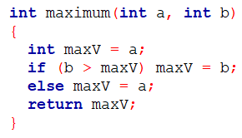
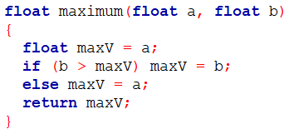
Why do we need function templates?
Consider the following two functions (Function to find the maximum):
Function to find maximum between
Two int numbers
Function to find maximum between
Two float numbers

Slide 4


Why do we need function templates?...(cntd)
So, what can be seen here?
The logic is exactly the same, but the data type is different.
For different data types we are writing similar yet different functions.
For more data types – more similar yet different functions.
Exhausting and time consuming.
What if there was a way in which we will just write one single function and this single function can work with different data types when required?
Function Templates

Slide 5
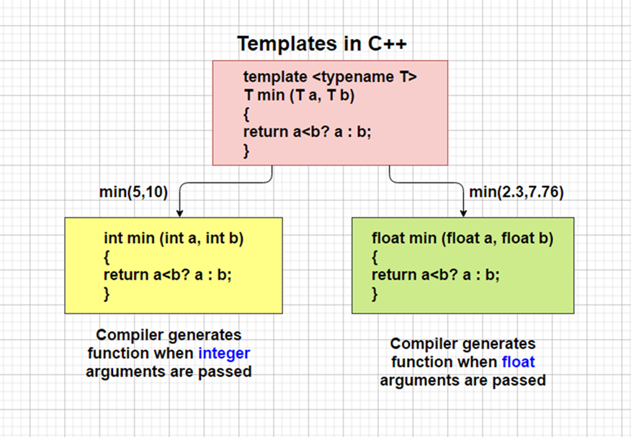

Let us first know about C++ Templates
What is that?
Example of Template Function and How it works
We will see the explanation later in this lecture.

Slide 6
Templates in C++
Simple and yet very powerful tool in C++.
Simple idea is to pass data types as a parameter so that we don’t need to write the same code for different data types (We will see practical examples later in this lecture).
Type-independent patterns that can work with multiple data types.
Benefits:
Generic programming
Reusable code

Slide 7
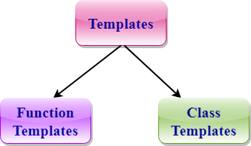
Types of Templates in C++
Function Templates
These define logic that works for multiple data types
Todays topic.
Class Templates
Class templates are useful when a class defines something that is independent of the data type
Discussion in next class.

Slide 8
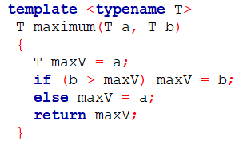
Function Templates
Function templates allow the logic to be written once and used for all data types – generic function.
Template function to find a maximum value:
//template declaration and T is
//placeholder type

Slide 9
Function Templates…. (Cntd)
After a function template is defined, the function can be used by passing parameters of real types.
template <typename T>
T maximum(T a, T b)
……
Int main()
{
int i1, i2;
Int m = maximum(i1, i2);
…..
}
maximum(i1, i2,) will invoke the template function with T=int. The function returns a value of int type.
Template function
T=int
Invoking template function

Slide 10
Function Templates…. (Cntd)
Each call to maximum() on a different data type forces the compiler to generate a different function using the template.
One copy of code for many types
int i1, i2;
// invoke int version of maximum
cout << "The maximum integer value is: "<< maximum( i1, i2 );
float f1, f2;
// invoke float version of maximum
cout << "The maximum float value is: "<< maximum( f1, f2 );
T=int
T=float

Slide 11

Function Templates…. (Cntd)
// One function works for all data types.
template <typename T>
T myMax(T x, T y)
{
return (x > y)? x: y;
}
int main()
{
cout << myMax <int>(3, 7) << endl; // call myMax for int
cout << myMax <char>('g', 'e') << endl; // call myMax for char
return 0;
}
Template function
T=int
Output:
T=char

Slide 12

How does it work?
Expanded at compiler time.
Compiler does type checking before template expansion.
Simple idea: Source code contains only the template function, but compiled code may contain multiple copies of same function.
Template function in source code
Compiler generated
functions according to
data types

Slide 13
Disadvantages
There are three primary drawbacks to the use of templates:
First, many compilers historically have very poor support for templates.
Second, almost all compilers produce confusing, unhelpful error messages when errors are detected in template code. This can make templates difficult to develop.
Third, each use of a template may cause the compiler to generate extra code (an instantiation of the template), so indiscriminate use of templates can lead to code bloat, resulting in excessively large executables.

Slide 14
Summary
To summarize function templates the following can be said:
By using function templates we can implement different data types.
Instead of using any particular data type we can use a template and then later convert it into any data type we want.
template <typename T> is a must.
Source code contains only the template function.
Expanded at compiler time.
Disadvantages – Compiler related.

Slide 15
References
“Templates in C++”, GeeksforGeeks, https://www.geeksforgeeks.org/templates-cpp/
“Templates”, cplusplus, https://www.cplusplus.com/doc/oldtutorial/templates/
“C++ Programming/Templates” https://en.wikibooks.org/wiki/C%2B%2B_Programming/Templates#:~:text=There%20are%20three%20primary%20drawbacks,are%20detected%20in%20template%20code.

Slide 16
Thank You!

